Slide 1
CFY & Beyond
Surviving – and Thriving! – In the Professional World
Heather Jeng, M.A., CCC-SLP
WSLHA Convention
October 10th, 2015

Slide 2
About you…
Students? Current CFs? CF supervisors & future CF supervisors?
Today’s talk is intended for ALL of the above roles
Web resource
  www.heatherjeng.com “CFY & Beyond” page on right side menu (may be at bottom of page if browser window is narrow—either maximize browser window or just scroll down)

Slide 3
Agenda
Purpose & Requirements of Clinical Fellowship Year
State Licensure
Evidence in Practice: EBP & PBE
Professional Goals After the Degree and CCCs
Mentoring & Supervision

Slide 4
Purpose of CFY
Straight from the horse’s mouth…:
  Integration and application of the theoretical knowledge from academic training
  Evaluation of strengths and identification of limitations
  Development and refinement of clinical skills consistent with the Scope of Practice
  Advancement from constant supervision to independent practitioner
  (American Speech-Language-Hearing Association)

Slide 5
Purpose of CFY
What the CFY is NOT meant to be:
a chance for the CF to supervise SLPAs, students, or other CFs
primarily administrative duties with limited patient contact
an academic teaching position
(Centeno & Jackson, 2013)

Slide 6
Requirements of CFY
35 weeks of full-time (=35 hrs/wk), for a total of 1260 hours
  Part-time equivalent to achieve 1260 hrs total also permissible, so long as working at least 5 hrs/wk
Mentored by a SLP with active CCCs
  It is the CF’s responsibility to verify that their mentor’s CCCs are active!!
3 or better rating on the CF Skills Inventory core skills
80% of time = direct clinical contact (assessment/diagnosis/evaluation, screening, treatment, report writing, family/client consultation, and/or counseling)
Submission of an approvable CF Report and Rating Form

Slide 7
Requirements of CFY
Supervision
  Minimum 18 direct, on-site observations of CF during clinical service provision
  Up to 6 hrs can be accumulated in 1 day
  If needed. interactive live audio/video conferencing counts as direct observation
  18 indirect monitoring activities (ex: reviewing documentation, consulting with co-workers & clients, monitoring CF’s participation in case conferences, etc.)
  Meet every segment to review & sign rating form

Slide 8
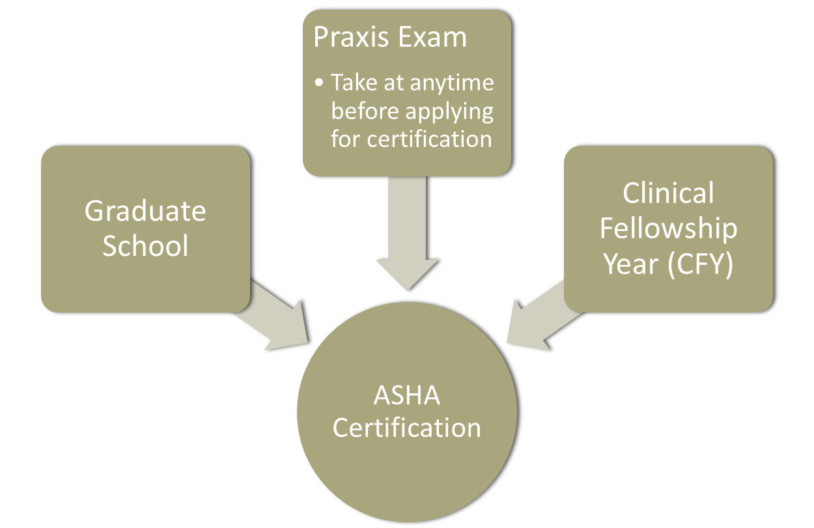
Requirements of CFY
Thanks, Kate & Kelsey!

Slide 9
Questions about CFY Purpose & Requirements?
FAQs
  What makes a good mentor?
  How to choose a site?
  How to address challenges that may arise (facility concerns, supervision concerns)?
  Changes in setting and/or work status (FT/PT)?

Slide 10
Agenda
Purpose & Requirements of Clinical Fellowship Year
State Licensure
Evidence in Practice: EBP & PBE
Professional Goals After the Degree and CCCs
Mentoring & Supervision

Slide 11
State Licensure
ASHA maintains a list of state requirements and organization contact information
  Terminology varies: Department of Health, State Board of Speech-Language Pathology & Audiology, etc.

Slide 12
State Licensure
WA = Department of Health
Must go through DoH to:
  Apply for Interim Permit and eventually, License
  Verify a license (supervisor’s; your own) via Provider Credential Search
  Change your contact information
  Renew your license
  File a complaint

Slide 13
State Licensure Process
Interim Permit requirements - Before Starting Job
  Application form + fee ($305.00)
  Master’s degree – must send official transcripts
  Completed Jurisprudence Exam (a test of state laws relating to practice of speech-language pathology)
  Practice under supervision of a WA-licensed SLP
  Acknowledgement of Responsibility Form completed by your supervisor
  4 hours of HIV/AIDS education and training

Slide 14
State Licensure Process
Interim Permit requirements – Ongoing
  Speech Language Pathologist Interim Permit Supervision Documentation Form needs to be sent in at the end of each three month time period

Slide 15
State Licensure Process
Full Licensure requirements
  Professional Reference Request Form completed by your supervisor and sent in
  Make sure Interim Permit Supervision Documentation Form was completed for the last 3-month interval and sent in
  Application fee ($321.00 SLP; $305.00 AuD)
  Praxis Exam
    SLP Passing score: 162
    Audiology Passing score: 170

Slide 16
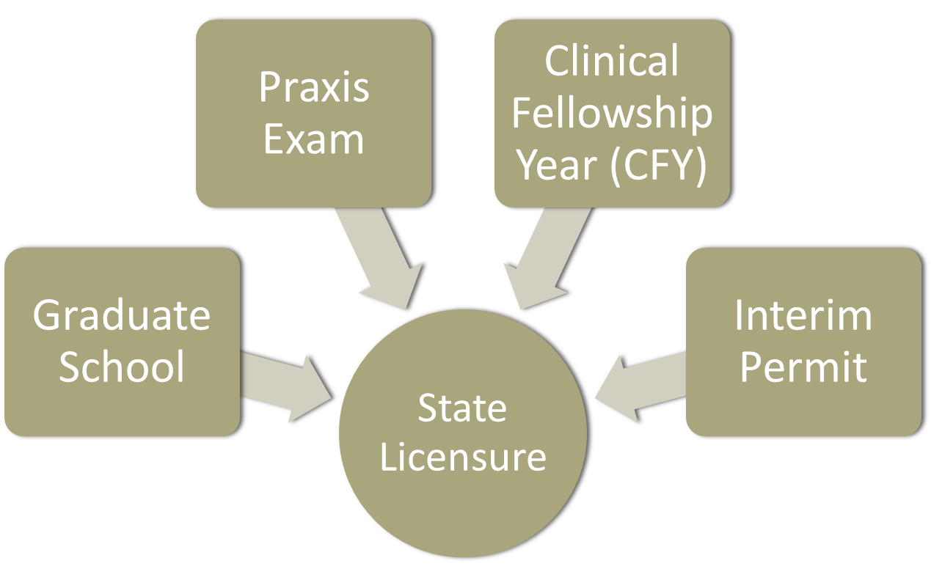
State Licensure Summary
Thanks again, Kate and Kelsey!

Slide 17
Agenda
Purpose & Requirements of Clinical Fellowship Year
State Licensure
Evidence in Practice: EBP & PBE
Professional Goals After the Degree and CCCs
Mentoring & Supervision

Slide 18
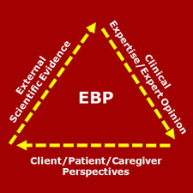
Clinical Practice and Evidence

Slide 19
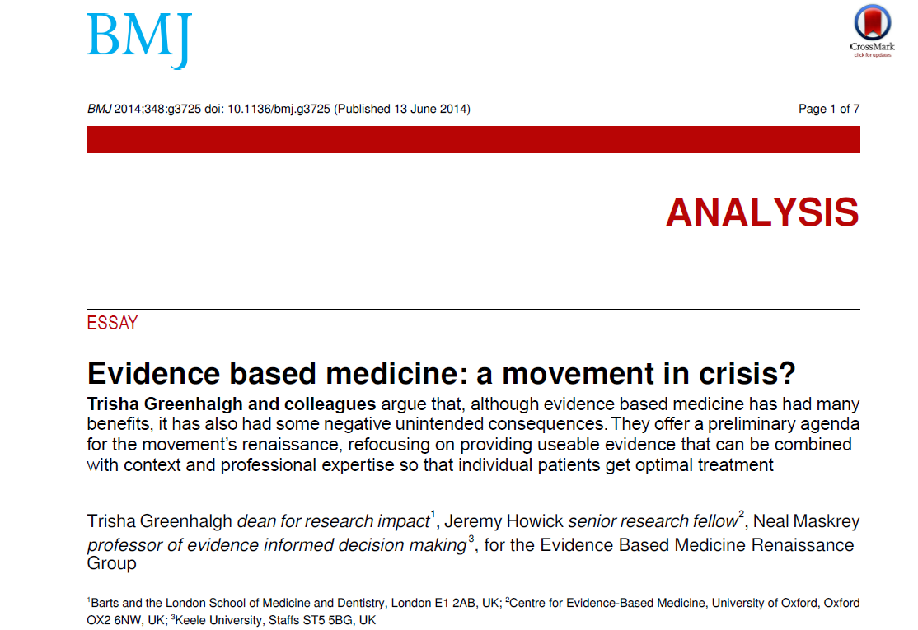
Limitations of Evidence-Based Medicine
Read me!

Slide 20
Limitations of Evidence-Based Medicine
Too much evidence!
  Recall: written by MDs. From SLP perspective, lucky them!!
Marginal gains and a shift from disease to risk
  SLP parallel: possible overuse of thickened liquids and altered textures for those deemed to be at risk of aspiration?
Overemphasis on following algorithmic rules
Poor fit for multiple morbidities
(Greenhalgh, Howick, & Maskrey, 2014)

Slide 21
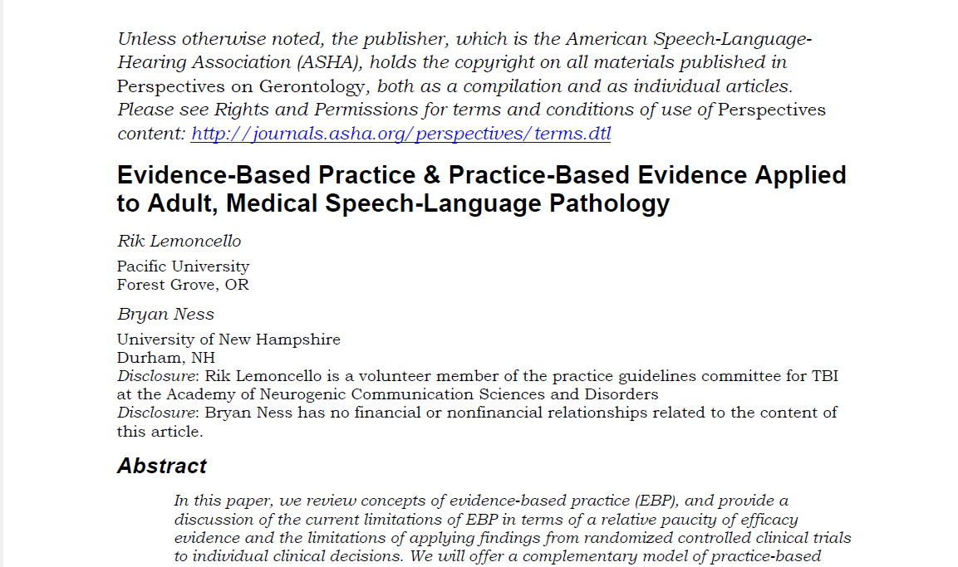
EBP in Speech & Hearing
Read me!

Slide 22
EBP in Speech & Hearing
Limitations:
Paucity of high-quality evidence to support or refute clinical decisions
Limitations of RCTs
  not every intervention can be explored via a RCT
  your client may not present like the study participants; even if your client matches the study’s participants well,
  they may have some crucial individual preferences that create a barrier to implementing the treatment as described
  (Lemoncello & Ness, 2013)

Slide 23
EBP in Speech & Hearing
Barriers to Implementation:
Limited time to engage with research evidence
Lack of knowledge and skills to access, summarize, and interpret the best current research
  (Lemoncello & Ness, 2013)

Slide 24
Practice-Based Evidence
Complements rather than replaces EBP!
  When high-quality evidence is available and fits with client’s preferences and values, use it!
  BUT if high-quality evidence is lacking, conflicting, does not relate to specific client, or does not provide one clear recommendation, then must use other methods to make clinical decisions
Produces evidence in the field
Cyclical

Slide 25
Suggested Methods of PBE
Single Case Studies using Multiple Baselines
Case Studies with Control Data

Slide 26
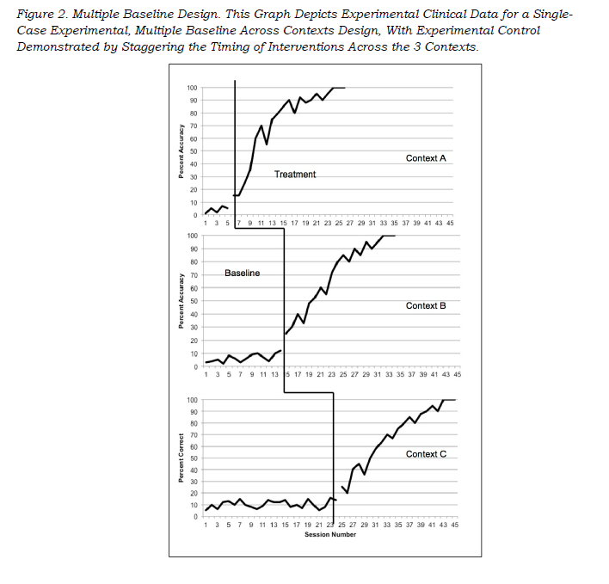
Single Case Studies Using Multiple Baselines
Notes:
Systematically examining treatment effects on a target behavior by varying the timing of intervention across 3 or more different conditions.
Example: safe use of assistive device across contexts (room, hallways, dining room in LTC).

Slide 27
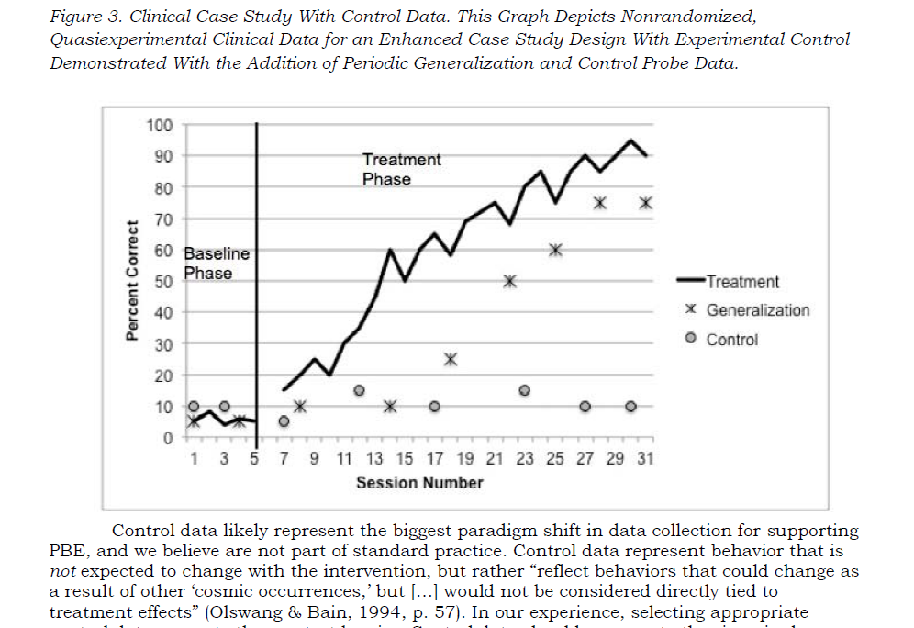
Case Studies with Control Data
Case Studies with Control Data
Notes:
Example from Lemoncello & Ness: Client s/p L hemisphere CVA with dysphagia, dysarthria, and aphasia. Targeting base of tongue retraction via lingual strengthening program. Would not reasonably anticipate that verbal naming ability would improve significantly if verbal expression is not simultaneously targeted in therapy.

Slide 28
Agenda
Purpose & Requirements of Clinical Fellowship Year
State Licensure
Evidence in Practice: EBP & PBE
Professional Goals After the Degree and CCCs
Mentoring & Supervision

Slide 29

Degree, Check! CCCs, Check! What Next?!

Slide 30
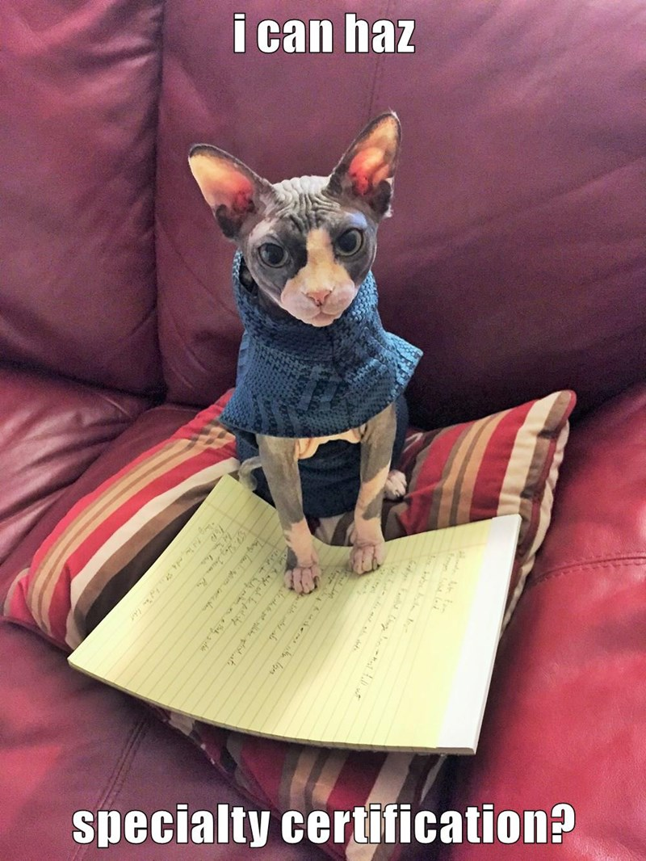
Degree, Check! CCCs, Check! What Next?!

Slide 31
Specialty Certifications
ASHA Council for Clinical Certification
  Child language and language disorders (SLP)
  Fluency and fluency disorders (SLP)
  Swallowing and swallowing disorders (SLP)
  Intraoperative monitoring (AuD)
Academy of Neurologic Communication Disorders and Sciences
  BC-ANCDS – Adult or Pediatric focus
Academy of Certified Brain Injury Specialists
  CBIS – Certified Brain Injury Specialist

Slide 32
Professional Development
CEU offerings
  Be a discerning consumer
Personal Learning Networks
  Twitter: #SLPeeps, #MedSLP, #WeSpeechies
  Facebook groups: School-Based Speech and Language Therapy, Dysphagia Therapy Group – Professional Edition, Adult Rehab Speech Therapy, many more
  Blogs, podcasts, … ?
Practice-based research networks

Slide 33
Professional Development
ASHA Special Interest Groups
  ASHA Community—professional forum = more formal
  Access to top academic experts
  Two-way street: the academics need a feedback loop from clinicians in the field

Slide 34
Professional Development
ASHA Clinicians and Researchers Collaborating (CLARC) program
WSLHA
  State-level advocacy
  Continuing education
  Professional community

Slide 35
Agenda
Purpose & Requirements of Clinical Fellowship Year
State Licensure
Evidence in Practice: EBP & PBE
Professional Goals After the Degree and CCCs
Mentoring & Supervision
Notes:
TIME CHECK: 18:00 = 2:42 PM

Slide 36
Mentoring and Supervision
Like any other area of practice….supervision requires knowledge and skills
  Preparation
  Intrapersonal Communication and the Supervisor-Supervisee Relationship
  Development of the Supervisee’s Critical Thinking and Problem-Solving Skills
  Development of the Supervisee’s Clinical Competence in Assessment and Treatment
  Supervisory Conferences
  Evaluating Growth
  Diversity (Ability, Race, Ethnicity, Class, Language, Gender, Age, Culture, Experience, Education)

Slide 37
Mentoring Supervision
Supervision is largely “honor system”
  Self-assessment, abiding by ASHA Knowledge and Skills Needed by SLPs Providing Clinical Supervision
  Supervision training requirements—question for the future
  State requirements: WA DoH Supervisors of Interim Permit Holders must be:
    Licensed in WA
    In good standing for at least 2 years

Slide 38
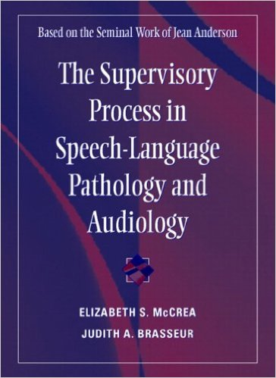
Mentoring and Supervision
Notes:
Other resources on website, including ASHA ethics statements and case studies relating to supervision—what do you do when supervisor and supervisee disagree, for ex.

Slide 39
Mentoring and Supervision
ASHA Students to Empowered Professionals (STEP) Mentoring Program
Local university community clinical education
Notes:
Resources specific to mentoring Clinical Fellows are on the website

Slide 40
Agenda
Purpose & Requirements of Clinical Fellowship Year
State Licensure
Evidence in Practice: EBP & PBE
Professional Goals After the Degree and CCCs
Mentoring & Supervision
Go forth and thrive--and join WSLHA!

